Slide 1
Site-Directed Integration of Large DNA Sequences into Endogenous Sites in the Human Genome using an engineered Modular Integrase (MINT) Platform
Jeffrey C Miller, Friedrich Fauser, Sebastian Arangundy Franklin, Luis Rodriguez, Nicola J Schmidt, Nicholas A Scarlott, Adeline Chen, Rakshaa Mureli, Bhakti N Kadam, Jessica E Davis, Lifeng Liu, Danny F Xia, Mohammad Qasim, Vishvesha Vaidya, Sarah J Hinkley, Emily C Tait, Bryan Bourgeois, Nga Nguyen, Stephen Lam, Andrew Nguyen, David Paschon, and Gregory Davis
FASEB Genome Engineering June 17, 2024

Slide 2
Disclosures
I am a full-time employee of Sangamo Therapeutics, Inc.
MINTTM is a trademark of Sangamo Therapeutics, Inc.
Notes:
These are my disclosures

Slide 3
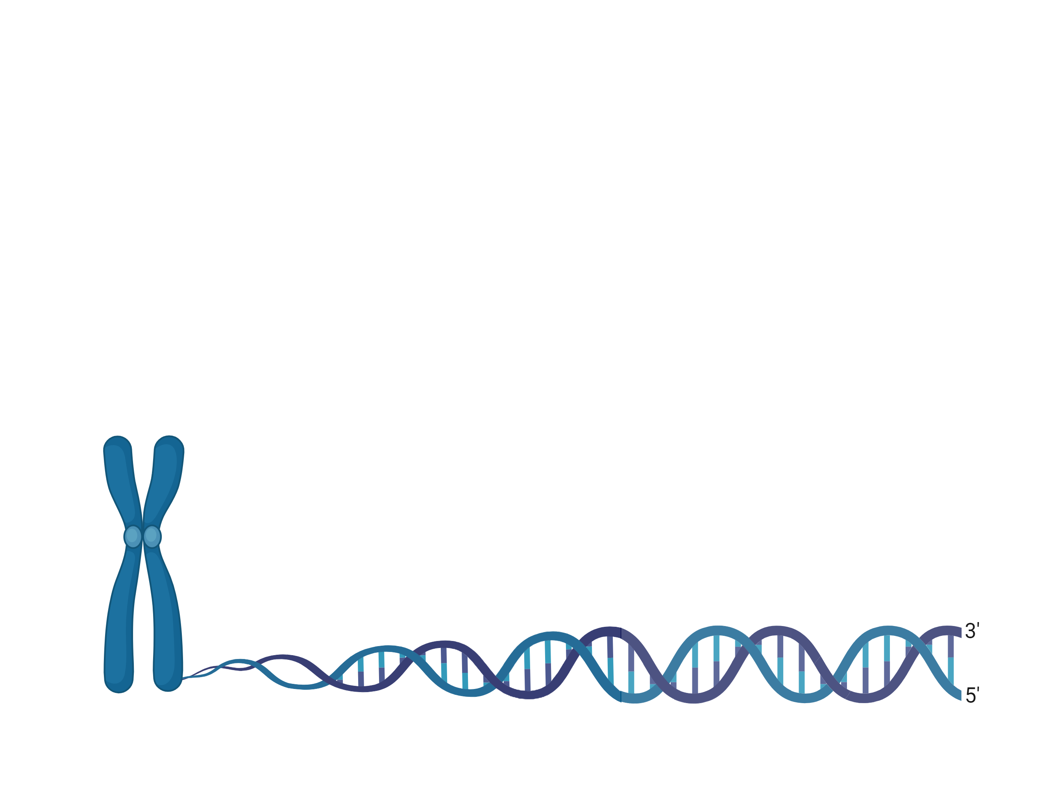
Integrases Will Write the Next Chapter of Genomic Medicine
Targeted integration of therapeutic DNA cargo (a gene)
Integrases meet the requirements for ideal therapeutic agents
...vs. single base editing
Capable of delivering large payloads - 10 kb+
“if it was possible to integrate very large DNA sequences where you could integrate entire genes or sets of genes into a targeted position in the genome [it] would be very powerful” –Jennifer Doudna
“a hypothetical fully programmable recombinase would be in some respects an ultimate genome editing agent” –David Liu
No copying required - low error rate
Self sufficient - no dependence on cell DNA repair machinery
No DNA breaks - reduced translocation risk
CRISPR roundtable
3
Notes:
Thank you for the invitation to present our work on Bxb1 integrase today. At Sangamo we believe that integrases will usher in a new era of genomic medicines.
We believe integrases have the potential to make targeted integration safer, simpler and with a lower risk for drug development.
On the top right you can contrast the outcomes of different gene editing events, and while there are many technologies right now that would allow you to make small genomic changes, what we really would like to do is to integrate therapeutic DNA cargo into human cells, either a gene or set of genes.
Integrases meet several requirements that would make them ideal therapeutic agents. An ideal integrase should deliver large payloads (greater than 10kb) do not require reverse transcription, and are independent of a cell’s DNA repair machinery, and importantly the fact that they do not induce DNA breaks which reduces translocation risks, and makes them promising for the development of therapies. Leaders in the field of gene editing have pointed out that the technology to achieve integration at your choice of sites in the genome would be the ideal gene editing agent.

Slide 4
Targeted Integration Improves Existing Therapies and Enables New Therapies
Random vs. Targeted Random Integration
One medicine to treat all mutations
Multiple mutations would require multiple medicines that make small changes
Cell 1
All cells,
one gene location
Patient 2
Cell 2
Exon 1
Exon 2
Patient 1
Patient 3
e.g. >965 FABRY mutations
Cell 3
Bxb1 + corrected transgene
Cell 4
SA
Stop
Exon 1
Correct cDNA
Exon 2
Cell N
One medicine to treat multiple mutations
Thousands of cells, different gene locations
Healthy Protein
Images by Biorender
Notes:
Integrase technology has the potential to make safer cell therapies, where instead of relying on the random integration from lentivirus for instance where each cell has integration events at different genomic loci, with an integrase you could insert a large gene, for example a CAR at a single genomic locus of your choice. Similarly, it would be a great approach to treat genetic diseases with a heterogeneous mutation landscape. For instance, by integrating a corrected transgene at the first intron of a diseased locus you could treat a patient population where disease causing-mutations are spread through the downstream exons.

Slide 5
Towards Cassette Exchange - the Ultimate Genome Engineering Tool
Ideal for simultaneously
changing multiple genes
X
X
+
synthetic
donor
X
X
Aspirational example: replace large regions of a chromosome such as the entire MHC locus to avoid transplant rejection
Two integrase pairs exchange everything in between
X
X
Images by Biorender
Notes:
Integrase technology has the potential to make safer cell therapies, where instead of relying on the random integration from lentivirus for instance where each cell has integration events at different genomic loci, with an integrase you could insert a large gene, for example a CAR at a single genomic locus of your choice. Similarly, it would be a great approach to treat genetic diseases with a heterogeneous mutation landscape. For instance, by integrating a corrected transgene at the first intron of a diseased locus you could treat a patient population where disease causing-mutations are spread through the downstream exons.

Slide 6
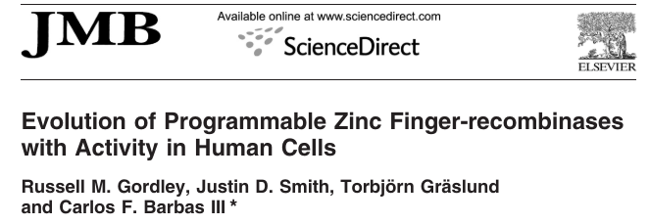
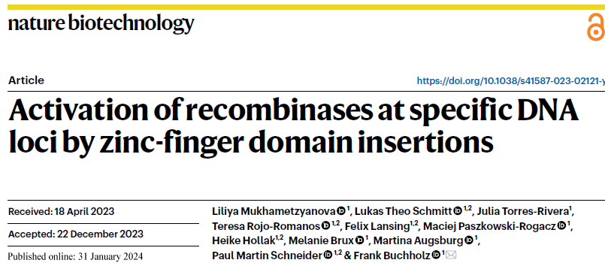
Retargeted Recombinases are a Long-standing Challenge for the Field
2003
2012
2016
2007
2016
2010
2011
2024

Slide 7
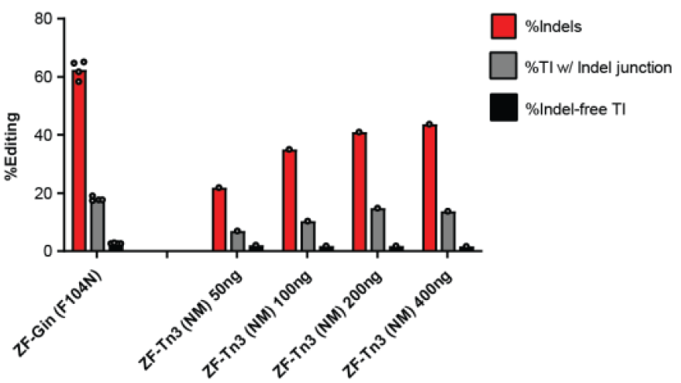
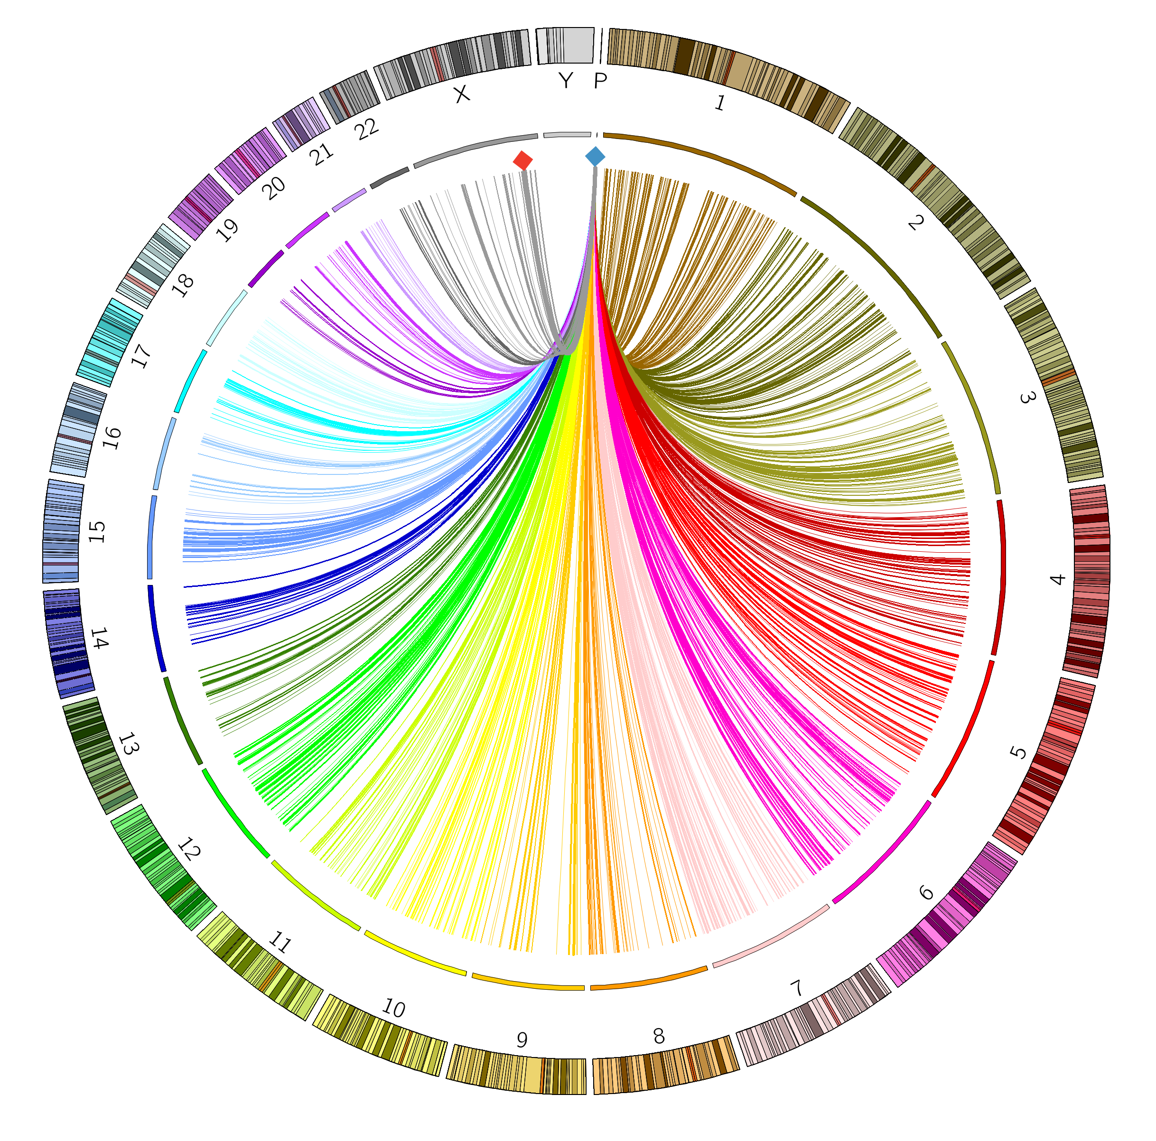
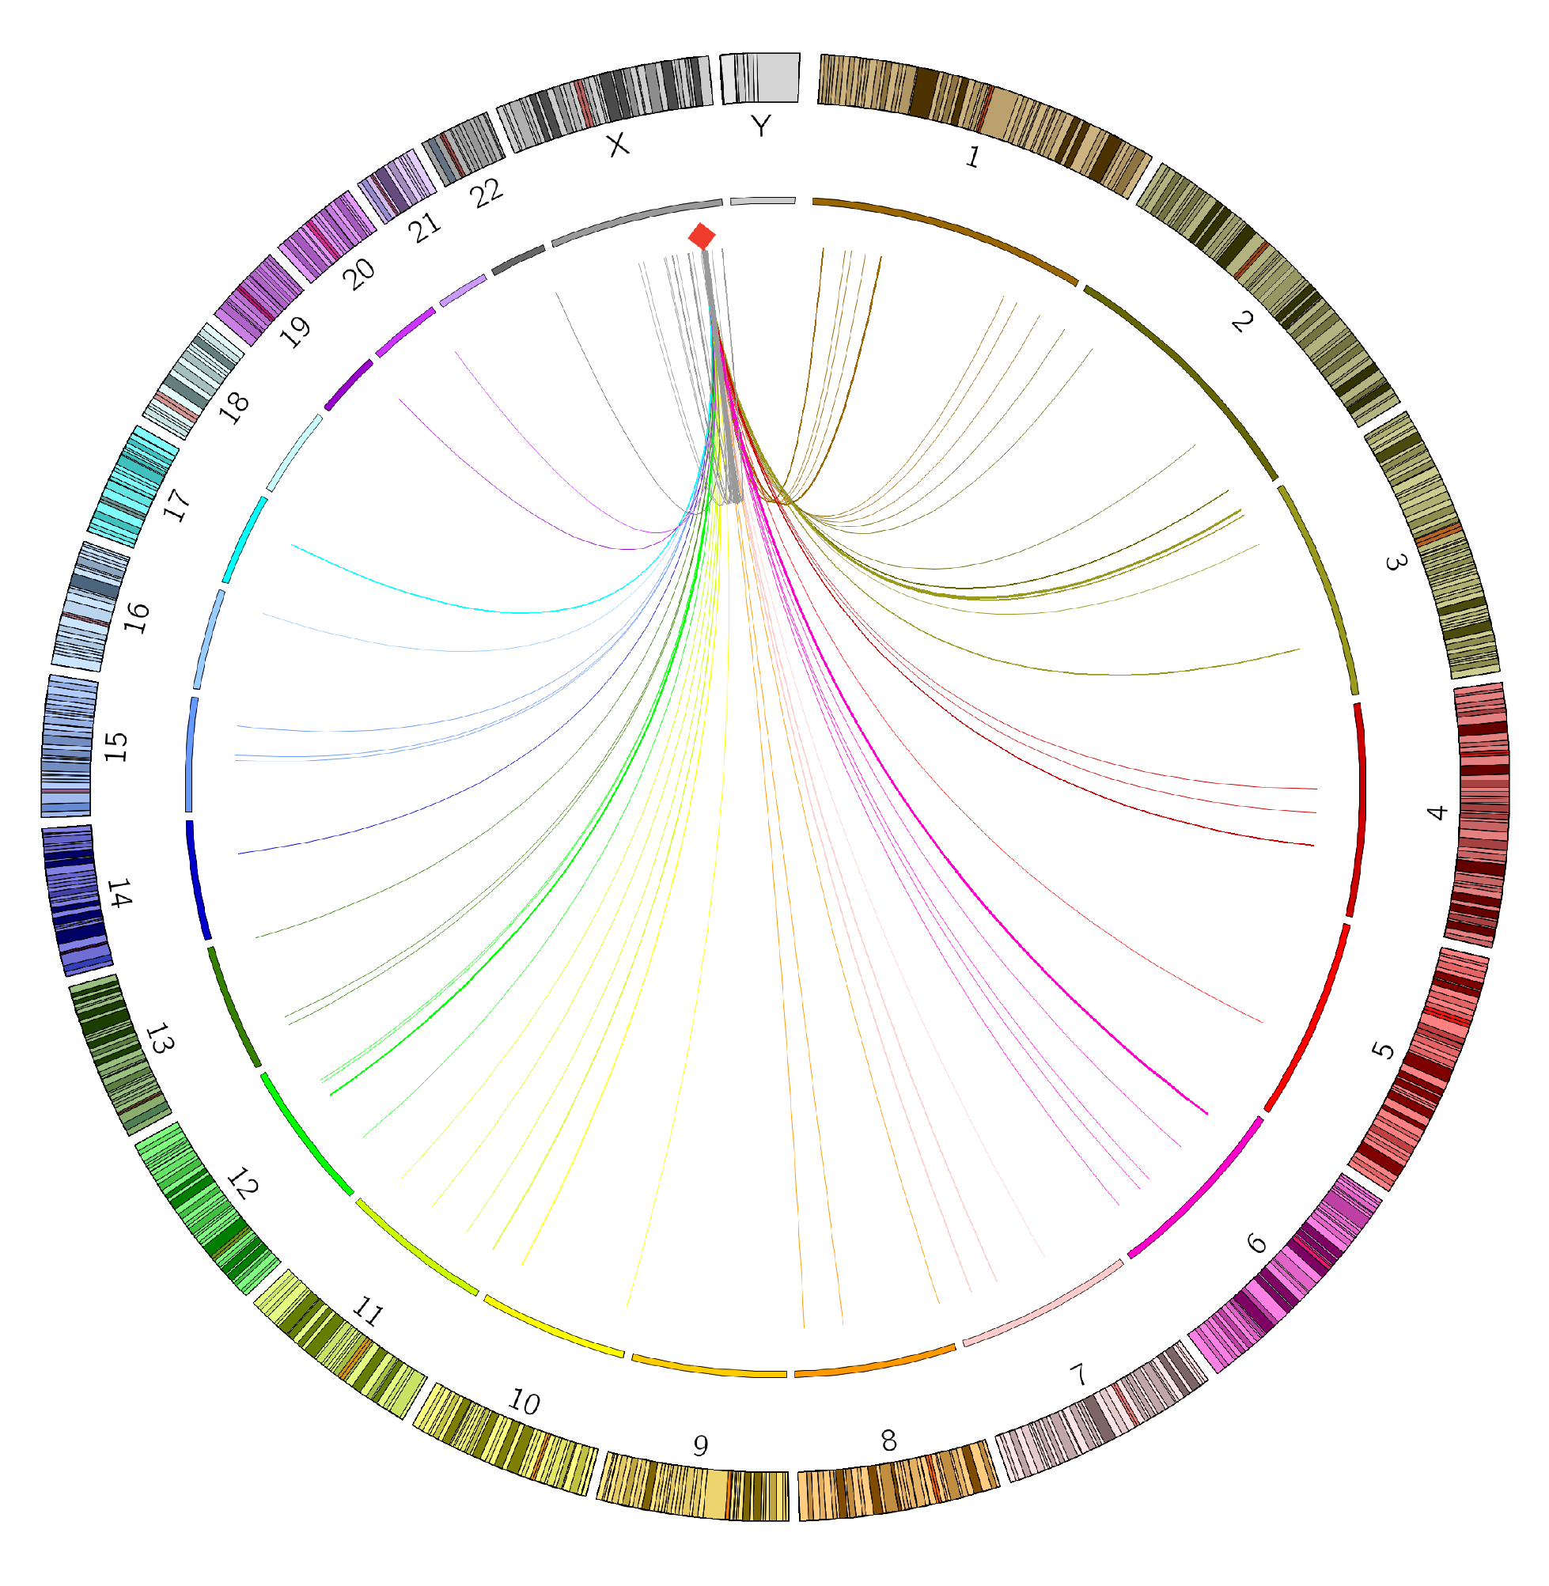
Recombinase Catalytic Domain Fusions can Result in Product Purity Issues
Editing in Human K562 cells
Taking the recombinase catalytic domain out of its native context is the likely cause of these issues
Intended target
Intended target
Donor
ZF-Gin
Genome-wide
integrations
ZF-Gin
Translocations
& Large Deletions
Jessica Davis

Slide 8
Reprogrammed Serine Integrases Would be Ideal for Therapeutic Applications
Synthetic Donor
Integrated Donor
ZD
RD
Genome Right
attP
Coiledcoils
Cat.
attB
Genome Left
Genome Right
Genome Left
Genomic Target Site​
Integrated Donor
Adapted from Gupta et al., NAR (2017)
Irreversible integration: Integrase coiled-coil domains ensure integration is unidirectional
Large cargo delivery: Native enzyme integrates 50 kb cargo into host genome
2 bp of specificity from donor: Central dinucleotides of attP and attB must match for integration
Components compatible with therapeutic delivery: enzyme is ~500 residues & no co-factors
Notes:
We chose to engineer the integrase from the Bxb1 phage as our candidate integrase for genomic medicines because it has been shown to be active in human cells. It also has an ideal mechanism for therapeutic targeted integration. In a therapeutic context, two integrase subunits would bind a synthetic donor, while another pair of subunits bind the genome, and once they form a tetramer, they simply carry out strand exchange, protecting the genome from double-strand breaks, and they do this in one direction thanks to their coiled coil domains. The natural enzyme integrates a 50kb cargo into the host genome, so there is potentially no limit to the size of the therapeutic cargo you could integrate.
However, Bxb1 has a narrow set of sequences it can target, so in the next few minutes I would like to take you through the process of how we have engineered the enzyme to target specific loci in the human genome.

Slide 9
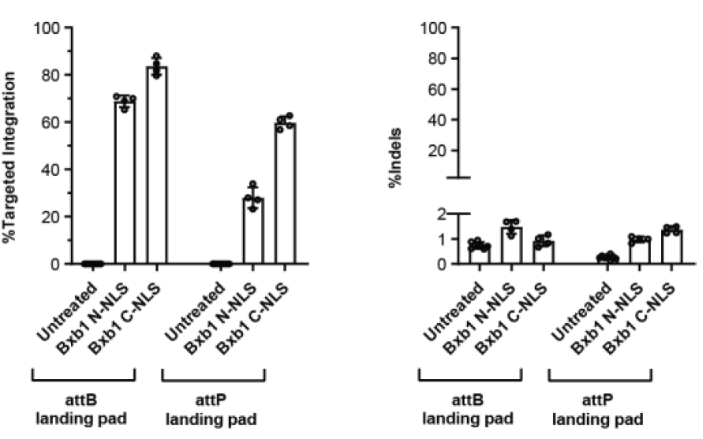
Reprogrammed Serine Integrases Would be Ideal for Therapeutic Applications
Synthetic Donor
Integrated Donor
ZD
RD
Genome Right
attP
Coiledcoils
Cat.
attB
Genome Left
Genome Right
Genome Left
Genomic Target Site​
Integrated Donor
Adapted from Gupta et al., NAR (2017)
Bhakti Kadam
Irreversible integration: Integrase coiled-coil domains ensure integration is unidirectional
Large cargo delivery: Native enzyme integrates 50 kb cargo into host genome
2 bp of specificity from donor: Central dinucleotides of attP and attB must match for integration
Components compatible with therapeutic delivery: enzyme is ~500 residues & no co-factors
Notes:
We chose to engineer the integrase from the Bxb1 phage as our candidate integrase for genomic medicines because it has been shown to be active in human cells. It also has an ideal mechanism for therapeutic targeted integration. In a therapeutic context, two integrase subunits would bind a synthetic donor, while another pair of subunits bind the genome, and once they form a tetramer, they simply carry out strand exchange, protecting the genome from double-strand breaks, and they do this in one direction thanks to their coiled coil domains. The natural enzyme integrates a 50kb cargo into the host genome, so there is potentially no limit to the size of the therapeutic cargo you could integrate.
However, Bxb1 has a narrow set of sequences it can target, so in the next few minutes I would like to take you through the process of how we have engineered the enzyme to target specific loci in the human genome.

Slide 10
Bxb1 Target Sites and Regulatory Mechanism
Left half-site
Right half-site
ZD
RD
RD
ZD
5’-GGTTTGTCTGGTCAACCACCGCGGTCTCAGTGGTGTACGGTACAAACC attP
CCAAACAGACCAGTTGGTGGCGCCAGAGTCACCACATGCCATGTTTGG-5’
5’-GGCTTGTCGACGACGGCGGTCTCCGTCGTCAGGATCAT attB
CCGAACAGCTGCTGCCGCCAGAGGCAGCAGTCCTAGTC-5’
Central dinucleotides
must match
ZD
RD
RD
ZD
ZD and RD 5 bp closer
ZD and RD 5 bp closer
Synthetic Donor
Integrated Donor
attB right half-site differs
from attB left half-site and
both attP half-sites
ZD
RD
Genome Right
attP
Coiledcoils
Cat.
attB
Bold bases enriched in Rec-seq
Bessen et al., Nat. Commun. 2019
Genome Left
Genome Right
Genome Left
Genomic Target Site​
Integrated Donor

Slide 11
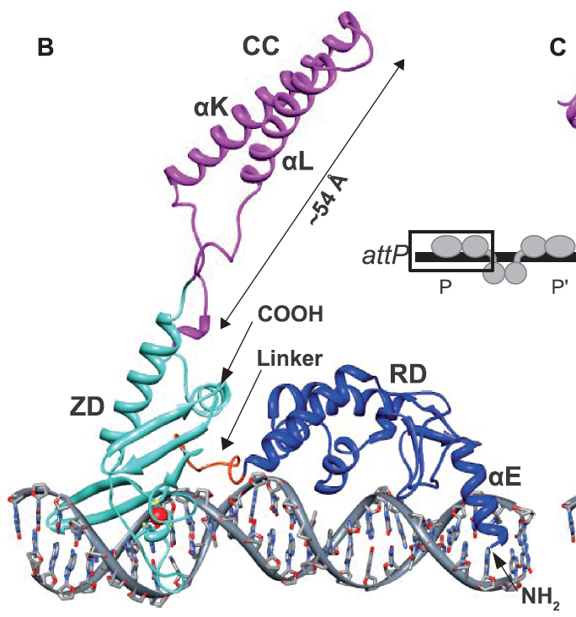
Challenges of Directly Reprogramming Bxb1 (i.e. why hasn’t anyone else done this yet?)
No “simple code” for Bxb1 reprogramming
Replacing DNA recognition domain with ZFs, TALEs, or CRISPRs will break control machinery
Will require re-engineering the protein-DNA interface (that’s what we do!)
No existing 3D crystal structure for Bxb1
Recent AI-methods don’t dock Bxb1 model with DNA correctly
Most relevant structure is of distantly related LI integrase
Loop
Helix
Linker
Hairpin
LI integrase structure – 4KIS.pdb
Alignment adapted from Rutheford et al., NAR 2013
Notes:
We chose to engineer the integrase from the Bxb1 phage as our candidate integrase for genomic medicines because it has been shown to be active in human cells. It also has an ideal mechanism for therapeutic targeted integration. In a therapeutic context, two integrase subunits would bind a synthetic donor, while another pair of subunits bind the genome, and once they form a tetramer, they simply carry out strand exchange, protecting the genome from double-strand breaks, and they do this in one direction thanks to their coiled coil domains. The natural enzyme integrates a 50kb cargo into the host genome, so there is potentially no limit to the size of the therapeutic cargo you could integrate.
However, Bxb1 has a narrow set of sequences it can target, so in the next few minutes I would like to take you through the process of how we have engineered the enzyme to target specific loci in the human genome.

Slide 12
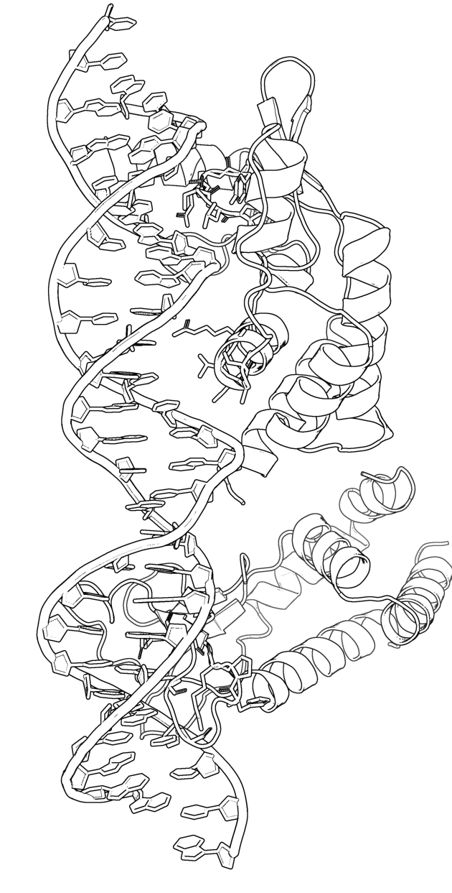
Our Integrase Reprogramming Strategy
Model
Directed evolution
Test and validate
AI-driven 3D Structural modeling
Experimental Mapping of DNA-protein interactions
Bacterial selection
Up to 1 billion mutants
Activity in human cells
Start with sites where wt Bxb1 has weak, but detectable activity
Images by Biorender
Notes:
Most protein engineering efforts would benefit greatly from knowing the structure of the protein you want to engineer,
so our process involved developing a testable structural model, mapping DNA-protein interactions,
then setting up a selection in bacteria that could test as many as 1 billion mutants per experiment to identify higher performing variants at new integration sites.
then the team tested and validated the results of selections in human cells.
My talk will focus on the modeling and directed evolution of modular integrases.
For more details on the validation in human cells, I invite you to visit my colleague Friederich Fauser’s poster tomorrow.

Slide 13
Bxb1 Target Sites within the Human Genome
Computational search based on data from Bessen et al. identified 8 attB-like sites with at least 0.1% TI, but no active attP-like sites identified
Genome-wide integration assay in K562 cells using a mixture of donor constructs with all possible central dinucleotide sequences identified 89 attB-like sites, but no attP-like sites
15 experimentally identified attB-like sites validated with at least 0.1% TI and 12 of 15 are in genes
Sequence logo of 89 experimentally identified sites is consistent with natural attB site
Left Half-site
Right Half-site
GGCTTGTCGACGACGGCGNNCTCCGTCGTCAGGATCAT
ZD
RD
RD
ZD
Patrick Li, Nick Scarlott, Jessica Davis, Frieder Fauser, Nicola Schmidt
Notes:
We chose to engineer the integrase from the Bxb1 phage as our candidate integrase for genomic medicines because it has been shown to be active in human cells. It also has an ideal mechanism for therapeutic targeted integration. In a therapeutic context, two integrase subunits would bind a synthetic donor, while another pair of subunits bind the genome, and once they form a tetramer, they simply carry out strand exchange, protecting the genome from double-strand breaks, and they do this in one direction thanks to their coiled coil domains. The natural enzyme integrates a 50kb cargo into the host genome, so there is potentially no limit to the size of the therapeutic cargo you could integrate.
However, Bxb1 has a narrow set of sequences it can target, so in the next few minutes I would like to take you through the process of how we have engineered the enzyme to target specific loci in the human genome.

Slide 14
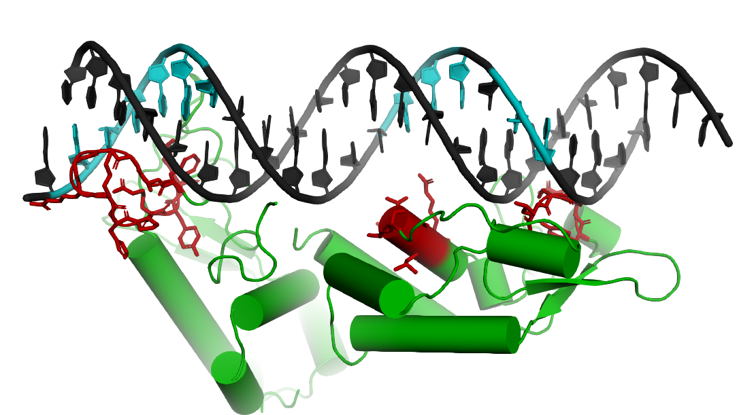
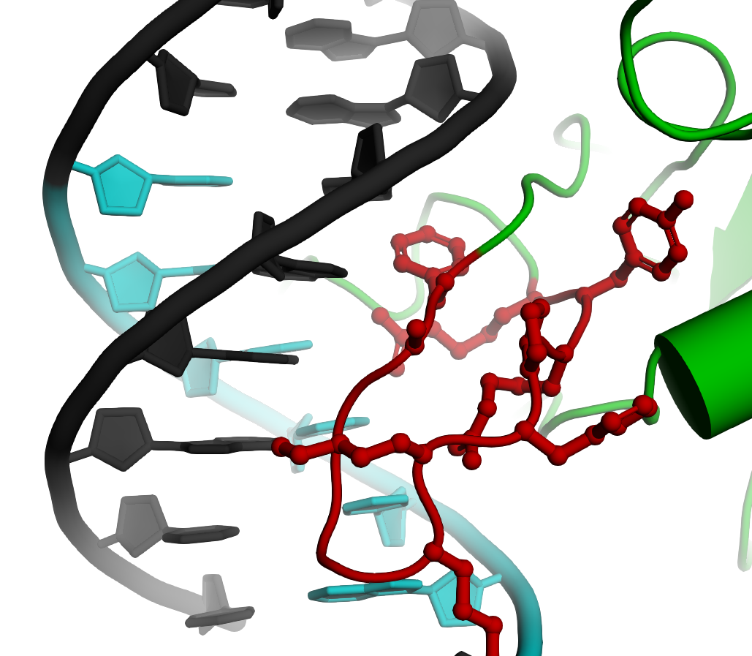
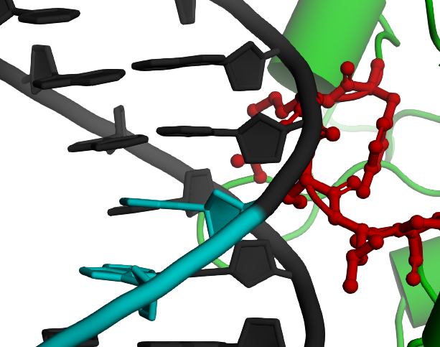
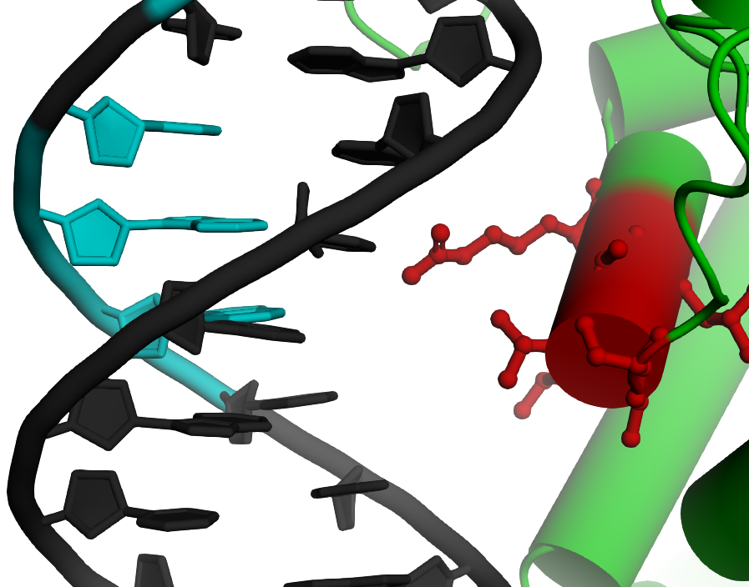
Structural Model and Mapped Interactions Suggest Bxb1 Engineering Strategy
Hairpin
Loop
Helix
FAGGGRKHPRYR
YRGSLP
DNA docking similar to
zinc finger recognition helix
Red: amino acid residues to randomize
Black: amino acids not randomized
Sebastian Arangundy
SATALKR
Notes:
Having both the structural model and experimental map helped inform on where to mutate the protein to build libraries to use in a selection experiment. Here I am showing the specific residues in the Bxb1 enzyme in red that were randomized to reprogram Bxb1 specificity at the hairpin, helix and loop submotifs at Sangamo.

Slide 15
Bacterial Selections can Reprogram the Bxb1 Helix
~1 billion variants
~100 candidate integrases
Bxb1 Variant Library
XXXXLXX
antibiotic selection
(single round)
Bxb1 natural half-site
GGCTTGTCGACGACGGCG
ATGCTCCTGTCGTCGGCG
Human DNA target half-site identified computationally
Sebastian
Arangundy
Target Construct
5’-GTC
5’-GTC
Luis
Rodriguez
CTG-5’
CTG-5’
interrupted
resistance gene
attB
attP
stuffer
Chaos
Order
Notes:
As a first proof of principle for this survival selection scheme, we tested whether we could reprogram Bxb1 to improve integration activity at a site in the human genome where wild-type Bxb1 had low but detectable activity. Shown on the left top is the Bxb1 WT binding half-site found in the Bxb1 phage host genome. Underneath is a site in the genome where WT bxb1 had low but detectable integration activity in human cells. Nucleotide changes from the BxB1 WT site are shown in red. This is the sequence we challenged the helix library to recombine. We build a library where we mutated the Bxb1 helix and sequencing this library showed no patterns as expected on the left. After this library went through a round of antibiotic survival selection, the surviving Bxb1 library variants collapsed into ~100 candidate integrases with a very clear pattern emerging in their helices.

Slide 16
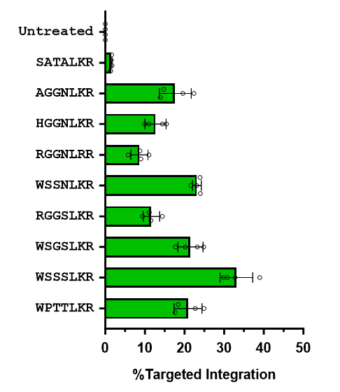
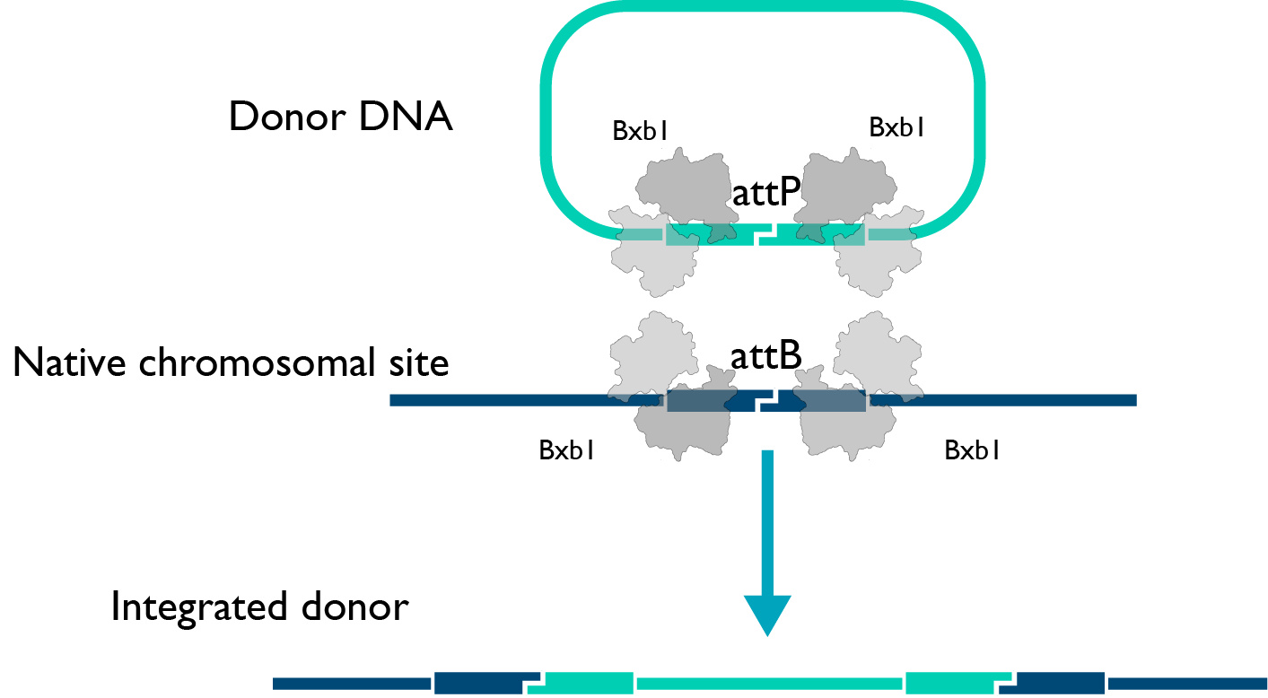
Selected Bxb1 Helices Enable Integration into the Genome of Human Cells
NGS integration assay
WT Bxb1
RD
RD
ZD
ZD
ZD
ZD
RD
RD
Frieder Fauser
Nicola Schmidt
Notes:
However, when we tested selected engineered Modular Integrases with mutant helices, we could dramatically improve activity to over 30% targeted integration, when measured by an NGS assay.
This result demonstrated that enrichment of integrase variants in our bacterial selection system translated into improved integration activity in human cells.

Slide 17
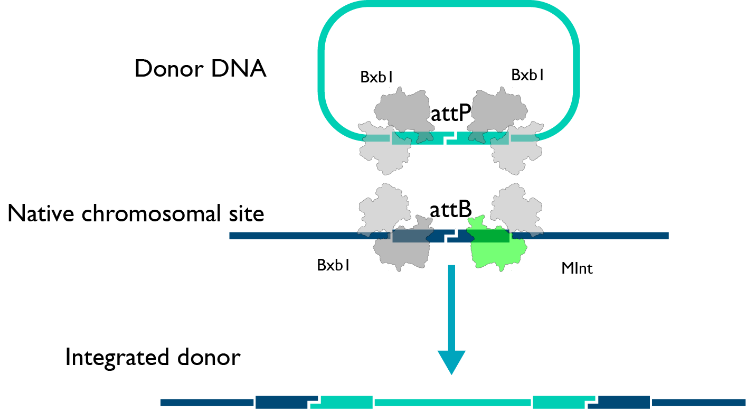
Selected Bxb1 Helices Enable Integration into the Genome of Human Cells
NGS integration assay
WT Bxb1
RD
RD
ZD
ZD
ZD
ZD
RD
RD
Helix variant
Frieder Fauser
Nicola Schmidt
Notes:
However, when we tested selected engineered Modular Integrases with mutant helices, we could dramatically improve activity to over 30% targeted integration, when measured by an NGS assay.
This result demonstrated that enrichment of integrase variants in our bacterial selection system translated into improved integration activity in human cells.

Slide 18
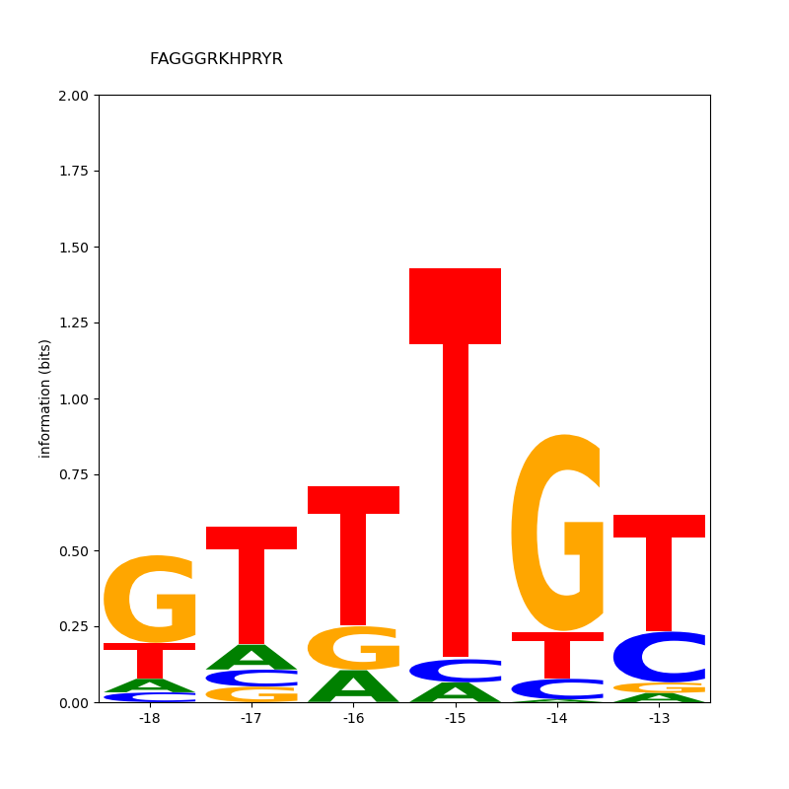
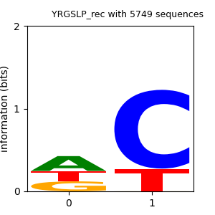
Specificity Characterization Using Random DNA Libraries in Bacteria
Wild-type Hairpin
Wild-type Helix
Wild-type Loop
FAGGGRKHPRYR
SATALKR
YRGSLP
Loop target library
NN
NN
NN
NN
-18 -17 -16 -15 -14 -13
-11
-10
-9
-7
-6
5’-GGTTTGTTGTTCGACGACGGCG-3’
Helix target library
Hairpin
Helix
Loop
NNN
NNN
NNN
NNN
Hairpin target library
NNNNNN
NNNNNN
NNNNNN
NNNNNN
Recombined targets
sequenced by NGS
Sebastian Arangundy
Notes:
Now that we knew we could engineer the helix submotif to improve Bxb1 performance in human cells, we decided to move forward with reprogramming the other submotifs. We carried out systematic selections against all possible targets for the helix and loop submotif and some targets for the hairpin submotif, and here I am showing what the DNA specificity of each submotif is in plasmid recombination assays. So you can see that the wild type submotifs have a clear preference but don’t have perfect specificity

Slide 19
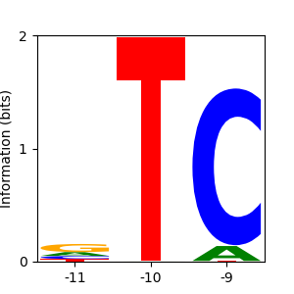
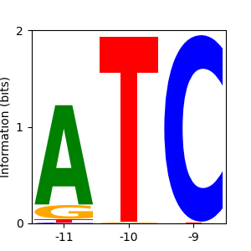
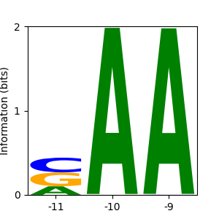
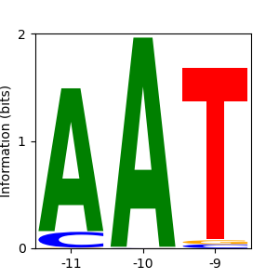
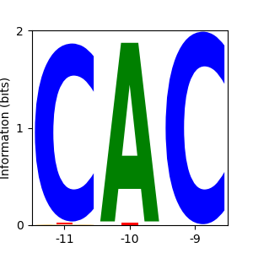
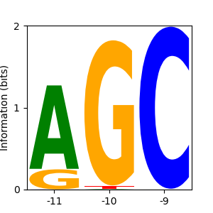
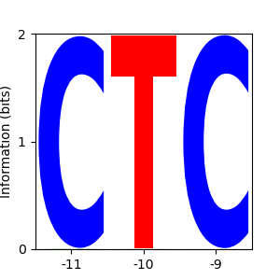
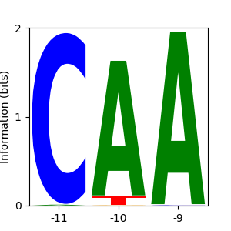
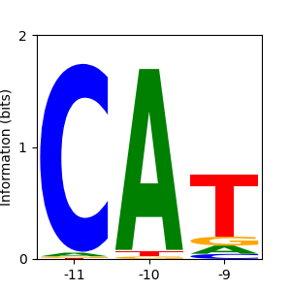
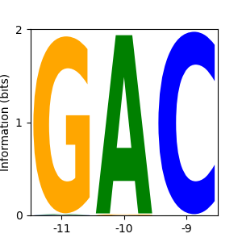
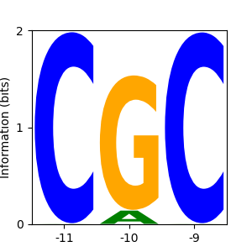
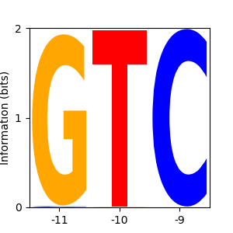
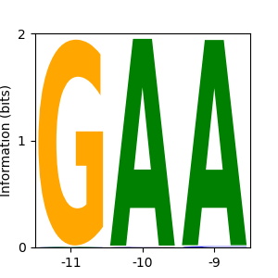
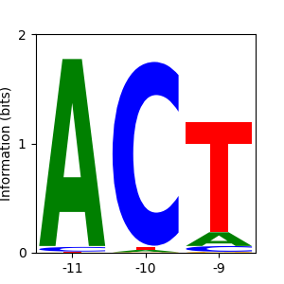
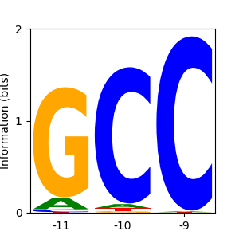
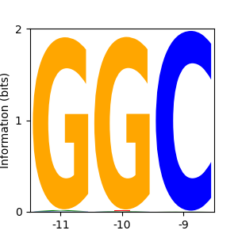
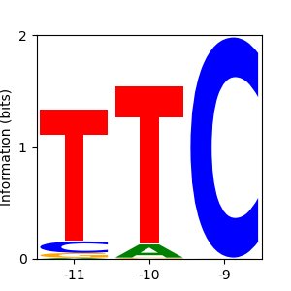
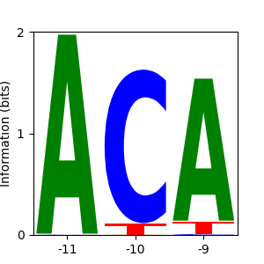
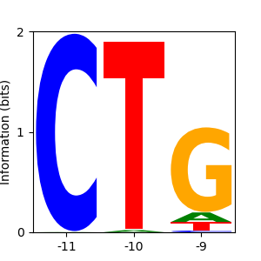
We Have Systematically Reprogrammed the Bxb1 Helix
Wild type Helix
SATALKR
AGGNLKR
LGTNLKR
SGTGLKK
SGSALKT
AAWALRR
GGRSLKR
SGYNLRR
SGWGLKK
SGWALRQ
64 helix selections
against different DNA targets
SARALSR
RADTLRR
YSRNLKR
SRNGLRK
RGHALKN
Sebastian Arangundy
GGSHLKR
TTRTLKR
AVQNLKR
RAAFLKK
RAWTLKC
Luis Rodriguez
Notes:
Here I am showing some of the best examples of our reprogramming, where we dramatically have shifted the specificity compared to the WT Bxb1 integrase at 19 different helix targets. For our reprogrammed variants there are some clear patterns starting to emerge in terms of how particular amino acid residues influence the DNA specificity of the integrase.

Slide 20
Patterns for Helix vs. DNA Target Resemble Zinc Finger-DNA Interactions
Wild type Helix
Zinc Finger
Examples
SATALKR
AGGNLKR
LGTNLKR
SGTGLKK
SGSALKT
AAWALRR
GGRSLKR
SGYNLRR
SGWGLKK
SGWALRQ
QSGTLRR ¹
TKAYLLK ¹
5’-
5’-
TCA
AGT
TGC
ACG
-5’
-5’
SARALSR
RADTLRR
YSRNLKR
SRNGLRK
RGHALKN
Zinc finger target normally shown as 5’-GCA-3’
Zinc finger target normally shown as 5’-TGA-3’
GGSHLKR
TTRTLKR
AVQNLKR
RAAFLKK
RAWTLKC
¹Ichikawa et al.
Nat. Biotech. 2023
Notes:
Here I am showing some of the best examples of our reprogramming, where we dramatically have shifted the specificity compared to the WT Bxb1 integrase at 19 different helix targets. For our reprogrammed variants there are some clear patterns starting to emerge in terms of how particular amino acid residues influence the DNA specificity of the integrase.

Slide 21
Patterns for Helix vs. DNA Target Resemble Zinc Finger-DNA Interactions
Zinc Finger
Examples
SATALKR
AGGNLKR
LGTNLKR
SGTGLKK
SGSALKT
DPSALIR¹
QSSNLRT¹
AAWALRR
GGRSLKR
SGYNLRR
SGWGLKK
SGWALRQ
5’-
GAT
CTA
5’-
TTT
AAA
-5’
-5’
QHTGLNQ²
SARALSR
RADTLRR
YSRNLKR
SRNGLRK
RGHALKN
5’-
TAT
ATA
-5’
¹Ichikawa et al.
Nat. Biotech. 2023
GGSHLKR
TTRTLKR
AVQNLKR
RAAFLKK
RAWTLKC
²Wolfe et al. Structure 2001
Notes:
Here I am showing some of the best examples of our reprogramming, where we dramatically have shifted the specificity compared to the WT Bxb1 integrase at 19 different helix targets. For our reprogrammed variants there are some clear patterns starting to emerge in terms of how particular amino acid residues influence the DNA specificity of the integrase.

Slide 22
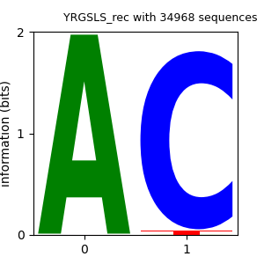
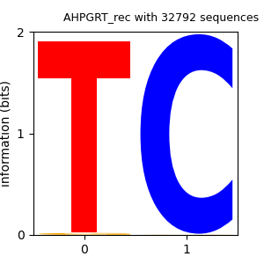
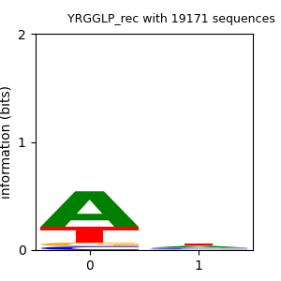
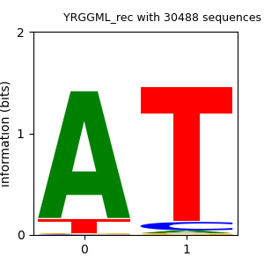
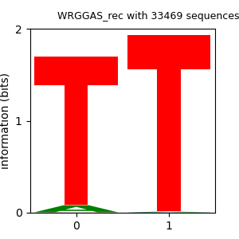
Loop Specificity Can be Reprogrammed
Wild type Loop
YRGSLP
YRGSLS
AHPGRT
16 loop selections
against different DNA targets
-7
-6
-7
-6
-7
-6
YRGGLP
YRGGML
WRGGAS
Sebastian Arangundy
Luis Rodriguez
-7
-6
-7
-6
-7
-6
Notes:
Furthermore, we have also performed selections against targets where the hairpin or loop target has been mutated, and we also see dramatic shifts in specificity of the selected Bxb1 variants, both in the hairpin submotif and the loop submotif.

Slide 23
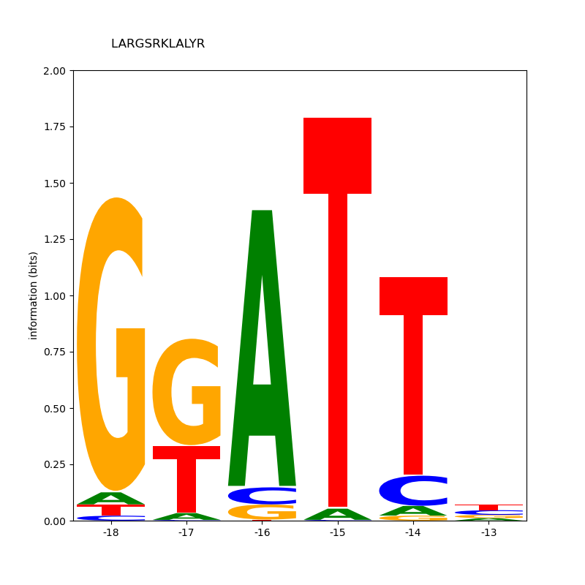
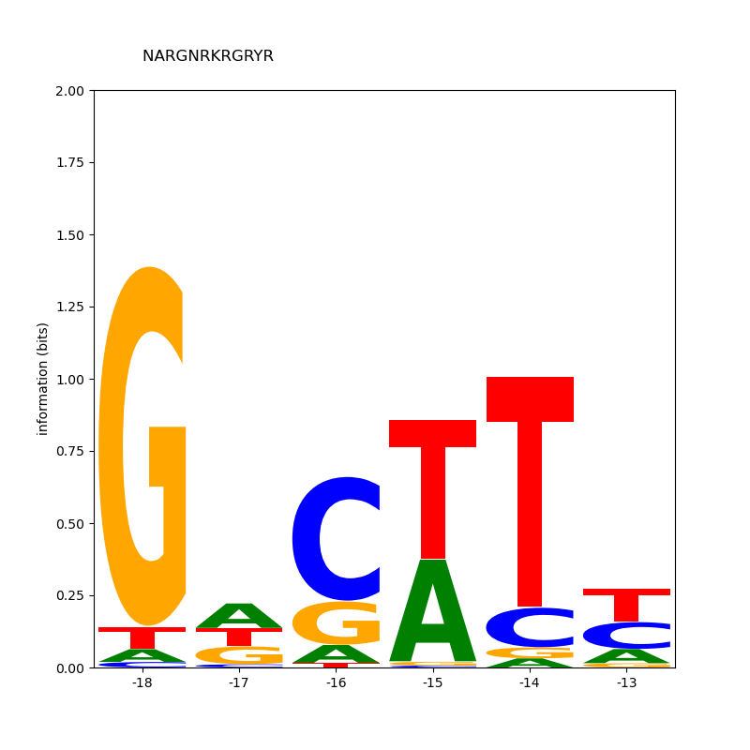
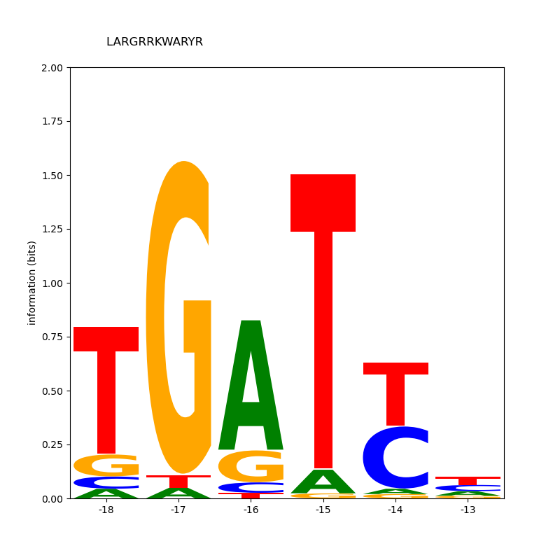
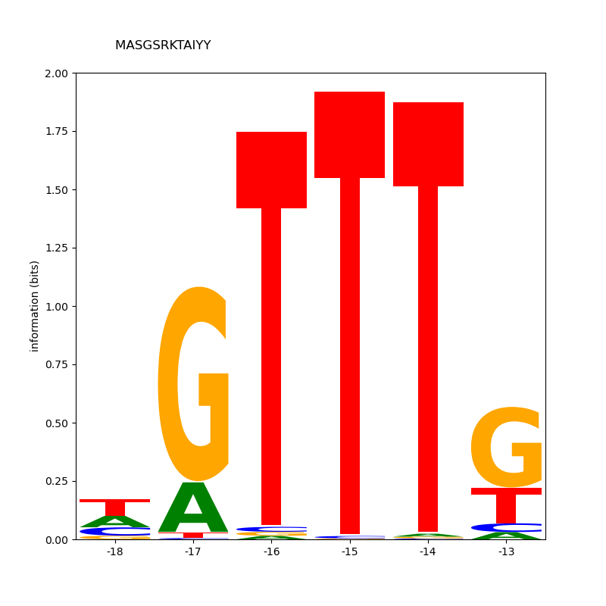
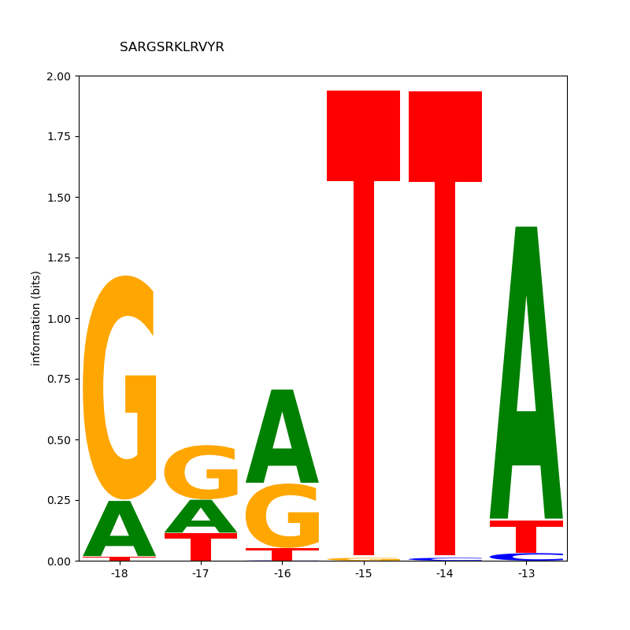
Hairpin Specificity can be Reprogrammed
FAGGGRKHPRYR (wt)
LARGSRKLALYR
NARGNRKRGRYR
-18 -17 -16 -15 -14 -13
-18 -17 -16 -15 -14 -13
-18 -17 -16 -15 -14 -13
>100 different
hairpin selections
against different DNA targets
LARGRRKWARYR
MASGSRKTAIYY
SARGSRKLRVYR
Sebastian Arangundy
Luis Rodriguez
-18 -17 -16 -15 -14 -13
-18 -17 -16 -15 -14 -13
-18 -17 -16 -15 -14 -13
Notes:
Furthermore, we have also performed selections against targets where the hairpin or loop target has been mutated, and we also see dramatic shifts in specificity of the selected Bxb1 variants, both in the hairpin submotif and the loop submotif.

Slide 24
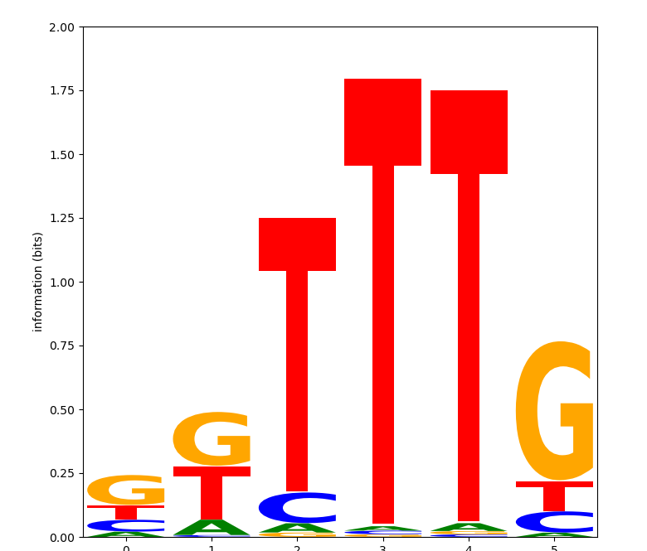
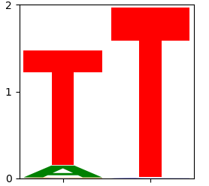
Reprogrammed Bxb1 Submotifs can be Combined to Target Desired Sites
Natural target half-site
GGCTTGTCGACGACGGCG
Human safe-harbor locus half-site
GGGTTTGAGTCCTTGGCA
Engineered submotifs
with novel DNA specificity
MASGSRKTAIYY
YSRNLKR
WRGGAS
Notes:
Finally, if we want to target sites in the human genome that are completely different from the WT Bxb1 DNA targets, can take our selected submotifs and assemble them modularly in order to target sequences that are simply not accessible by the WT enzyme, for instance here I am showing an example of how one could do this for a half-site in a human safe harbor locus.

Slide 25
Strategy for Systematic Reprogramming Bxb1 to Target Human Sites
quarter-sites
half-sites
full-site
(Loop is wild-type)
Frieder Fauser
Nicola Schmidt
Notes:
Now that we knew we could engineer the helix submotif to improve Bxb1 performance in human cells, we decided to move forward with reprogramming the other submotifs. We carried out systematic selections against all possible targets for the helix and loop submotif and some targets for the hairpin submotif, and here I am showing what the DNA specificity of each submotif is in plasmid recombination assays. So you can see that the wild type submotifs have a clear preference but don’t have perfect specificity

Slide 26
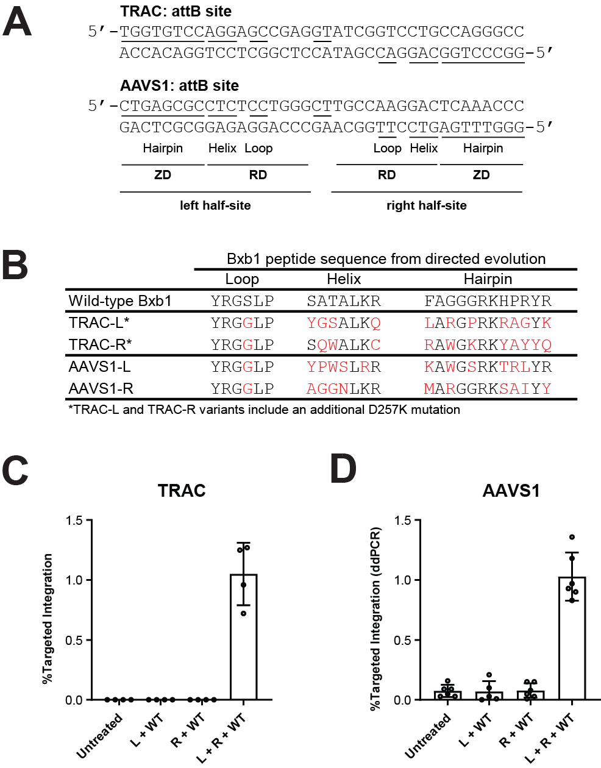
This Strategy Works at Therapeutically Relevant Sites within the Human Genome
Frieder Fauser
Rakshaa Mureli
Lifeng Liu
Nga Nguyen
Notes:
Now that we knew we could engineer the helix submotif to improve Bxb1 performance in human cells, we decided to move forward with reprogramming the other submotifs. We carried out systematic selections against all possible targets for the helix and loop submotif and some targets for the hairpin submotif, and here I am showing what the DNA specificity of each submotif is in plasmid recombination assays. So you can see that the wild type submotifs have a clear preference but don’t have perfect specificity

Slide 27
This Strategy Should Work with a Wide Variety of Natural Integrases
Bxb1
Pa01
Kp03
Nm60
Si74
BcyInt
SscInt
Durrant et al. Nat Biotech (2022)
Yarnall et al. Nat Biotech (2023)
Sebastian Arangundy
Notes:
Now, we believe that our strategy could be adapted to other integrase variants described in the literature. Here I am showing an alignment of structural models from these generated by rosettafold, and when we dock the individual DNA binding domains of the proteins to DNA, we can see that the DNA binding motifs, the hairpin, helix and loop are also conserved in recently discovered integrases

Slide 28
Summary
Demonstrated serine integrase reprogramming for the first time
The MINT platform enables insertion of large DNA cargo into the human genome
The MINT platform should unlock new ways to treat genetic diseases
Reprogramming strategy will likely apply to other integrases
doi.org/10.1101/2024.05.09.593242
Notes:
To summarize, we have been able to reprogram the Bxb1 integrase to new target sequences that are very divergent from their natural targets, and these engineered integrases can facilitate insertion of large cargo into the human genome.
We believe our approach unlocks new ways to treat genetic diseases with a heterogeneous mutational landscape and also enables safer cell therapies.
Because integrases show high structural conservation even at very low sequence conservation, one could apply the same reprogramming methods to other integrases

Slide 29
Thanks – Q&A
Sandy Macrae Jason Fontenot Greg Davis
Jeff Miller
Sebastian Arangundy Luis Rodriguez
Frieder Fauser Nicola Schmidt Rakshaa Mureli
Jessica Davis Danny Xia
Dave Paschon Lifeng Liu Nga Nguyen
Adeline Chen
Yuri Bendaña Garrett Lew
Jason Eshleman
Hamed Masnadi-Shirazi
Alumni Patrick Li Nicholas Scarlott Bhakti Kadam Andrew Nguyen Mohammad Qasim Vishvesha Vaidya

